Slide 1


AN INTERNSHIP REPORTON “CODEITBOT:REVOLUTIONIZING INTERNHIRING”
BY BISHAL GIRI
Symbol no :24600/076
TU reg no : 5-2-0459-0001-2019

Slide 2

INTRODUCTION
CodeIT Bot is a web-based system designed to conduct prequalification coding exams for
students and general users aspiring to apply for internships at Code IT. This application
serves as a preliminary screening tool, directing applicants to complete a series of online tests
before directly contacting the HR department.

Slide 3

WHYCODEITBOT?
Challenges in Prequalifying Candidates Provides automated Efficient Prequalification
Reduce HR Workload
Higher Quality Candidate Selection

Slide 4
OBJECTIVE
01
Automate prequalification coding exams.
02
Identify top talent based on coding proficiency.
03
Improve resource allocation for HR.

Slide 5


SCOPE
01
Professional Development and Experience:
02
Role as a Frontend Developer
03
Personal Growth and Challenges Overcome
04
Importance of Effective Communication and Agile Methodologies

Slide 6
PROBLEM
01
Respect for Privacy Policies
02
Confidentiality in Economic Details
03
Time Constraints and Project Complexity

Slide 7
INTRODUCTIONTOORAGANIZATION
Certified Software Development Web Development Company
Headquartered in Prithivi Path, Dharan-1 Services to Small and Large Corporate Houses ,Individuals and Entrepreneur Proven Competency in Technology Sector

Slide 8

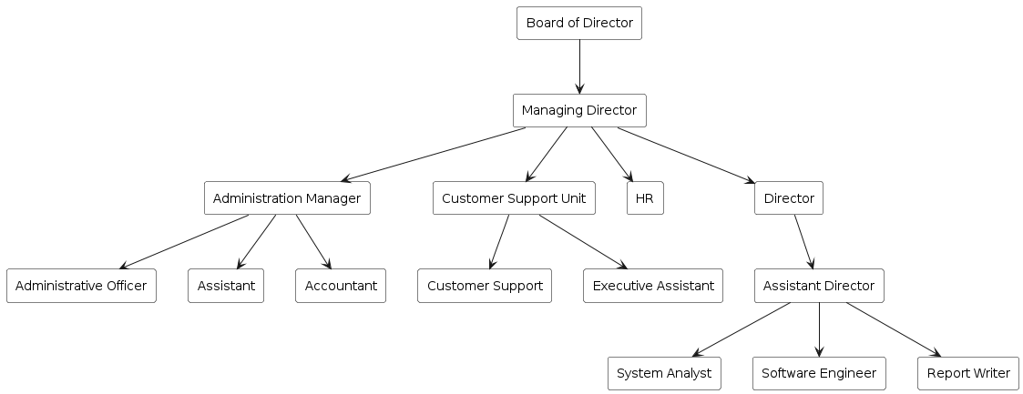

ORGANIZATIONAL STRUCTURE

Slide 9
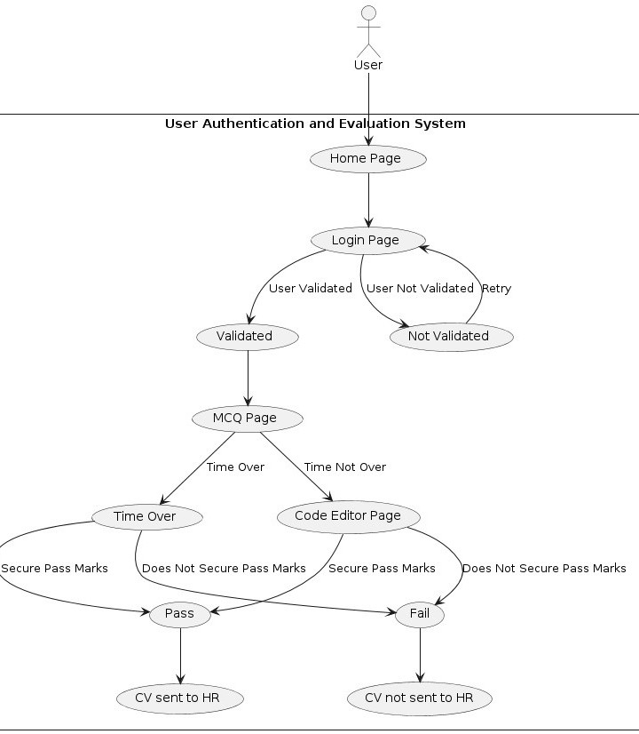

WORKING FLOW OF OUR PROPOSED SYSTEM(CODEIT BOT) :

Slide 10
WEEKLY LOG
Integrated frontend with backend for seamless communication and defined the
proper routing
Find out the way to give score for user answer and implemented scoring system
Researching about the way to validate user and implemented user authentication
Week 1
Week 2
Week3
Week 4
Week 5
Week 6
Introduction to the team and research for learning was done.
Finding out the way to validate user answer and implemented the resulting idea to validate user’s answer of code editor
Developed frontend interfaces for examtaking,
review, and tracking the user score and details.

Slide 11
WEEKLY LOG
Integrated the system where after finishing the test, user can download and review their
provided answer and automatically send the mail to HR team with user’s CV only if user pass the exam
Made small adjustments to how the website
looks and works based on feedback from people testing it, so it's easier and more enjoyable for users
Finalize the software with all the necessary testing and validation
Week 7
Week 8
Week 9
Week 10
Week 11
Week 12
Integrated timing mechanism with clock in
the website giving only limited time to user
to solve the question.
Conducted manual testing and debugging to
ensure functionality and reliability.
Perform more user answer validation technique by modifying the algorithm

Slide 12
TECHNOLOGY USED IN PROJECT
REACTAND TAILWIND
NODEJSAND EXPRESS
Node.js for Backend Development
Express.js for Web Framework Integration with Nodemailer API
React for Dynamic User Interfaces
Tailwind CSS for Styling User-friendly Interface

Slide 13

FUNCTIONALITYOFSOFTWARE
Conducts online tests to screen applicants and determine eligibility for internship
Forwards CVs of high scorers
Allows users to review submitted answers Provides an interactive and user-friendly interface with secure access

Slide 14


OUTCOMEOFINTERNSHIP
·Learned about basics of React and Node.
·Learned about APIs and seamless flow between react and node.
·Learned communication skills to work in a team effectively.
·Learned about the software development procedures.
·Learned limited time and resource management.

Slide 15


CONCLUSION
Familiarization with React and Node.js Development Process: UX/UI design, interactive UI, login page, code editor, MCQ page
Efficient Routing Implementation Gained Confidence and Experience in IT and Application Development

Slide 16
REFERENCE
Kapoor, A. a.-M. (2020). Exploring the participation of CS undergraduate students in industry internships. Proceedings of the 51st ACM Technical Symposium on Computer Science Education , 1103-1109.
Kotwal, D. V. (2016). Online examination system. International Research Journal of Engineering and Technology (IRJET , 115-117.
Sapre, S. S. (2021). AI-ML based smart online examination framework. International conference on deep learning, artificial intelligence and robotics , 17-25.
SWeaver, D. e. (2005). Evaluation: WebCT and the student. Evaluations and Assessment Conference .
Younis, M. I. (2015). Construction of an online examination system with resumption and randomization capabilities. International Journal of Computing , 62-82.

Slide 17
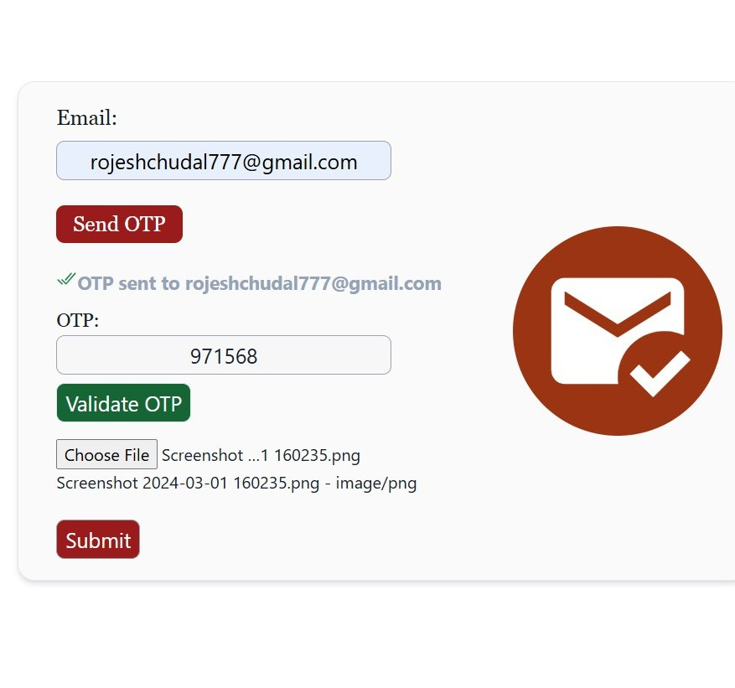
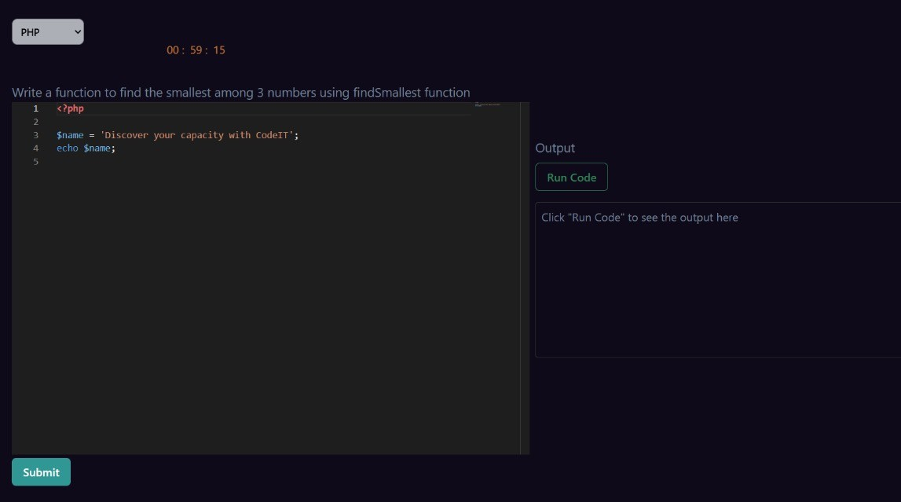
APPENDIX

Slide 18
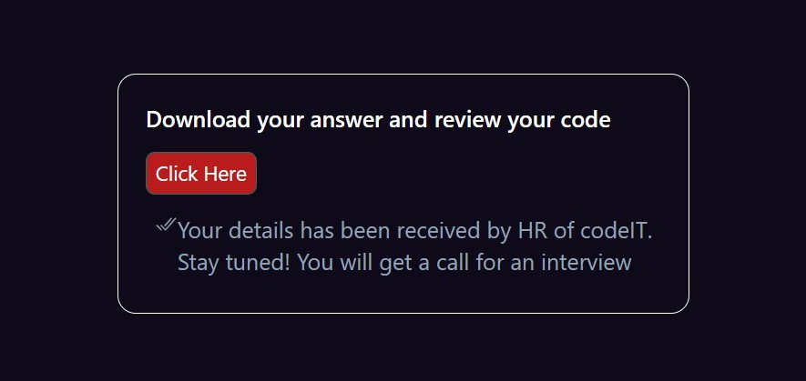

APPENDIX

Slide 19
THANKYOU
VERY MUCH

